Slide 1


Leveraging Large Language Models for Marketing Analytics

Slide 2

Table of Contents
Value Proposition
Project Goal
Hypothesis
Method
Experiments
Conclusion
Final presentation
Notes:
Good morning everyone. In this final presentation of our Project, we will walk you through the key aspects of our project, starting with our Value Proposition, which defines the benefit we aim to deliver. We'll then outline our Project Goal, setting the stage for what we hope to achieve.
Next, we'll introduce our Hypothesis, the assumption guiding our research, followed by our Method, where we explain our approach to testing it. We'll then delve into the Experiments conducted, sharing key insights from our findings. Finally, we'll wrap up with our Conclusion, summarizing our results and their implications.
Let’s get started!

Slide 3
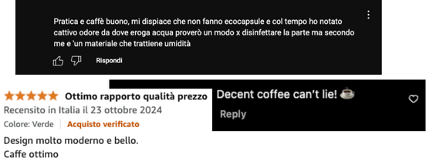

Project Value Proposition
For marketers seeking deeper insights on product launches, our analytics software transforms raw online comments and reviews into actionable metrics.
Notes:
For marketers seeking deeper insights on product launches, our analytics software transforms raw online comments and reviews into actionable metrics. By leveraging advanced data processing techniques, we help businesses uncover consumer sentiment, identify trends, and make data-driven decisions with confidence.

Slide 4

Project Goal
Developing AI software to accurately assess the real impact of a product launch by analyzing consumer sentiment across social media comments and third-party reviews.
Responsible
Consumption
and Production
Sustainable Development Goal:
Notes:
Our goal is to develop AI software that accurately assesses the real impact of a product launch by analyzing consumer sentiment across social media comments and third-party reviews. By doing so, we provide businesses with deeper insights into customer perceptions and market reception. Additionally, our project aligns with SDG 12: Responsible Consumption and Production, as we strive to promote more sustainable and informed decision-making in product development and marketing.

Slide 5
Hypotheses
Large Language Models can be effectively used to extract valuable insights from consumer comments and reviews to enhance marketing strategies.
Specifically:
LLMs can effectively identify product-relevant comments.
LLMs can extract key product aspects from reviews sand comments and assign appropriate sentiments to each.
LLMs can successfully assess sentiment in comments and assign rating stars to reviews.
Notes:
Our hypotheses center on the effectiveness of Large Language Models (LLMs) in extracting valuable insights from consumer comments and reviews to enhance marketing strategies. Specifically, we propose that:
LLMs can effectively identify product-relevant comments, filtering out irrelevant information and focusing on consumer discussions that matter.
LLMs can extract key product aspects from reviews and assign appropriate sentiments to each, providing a more understanding of customer feedback.
LLMs can successfully assess star rating for reviews, helping businesses quantify consumer perceptions more effectively.

Slide 6
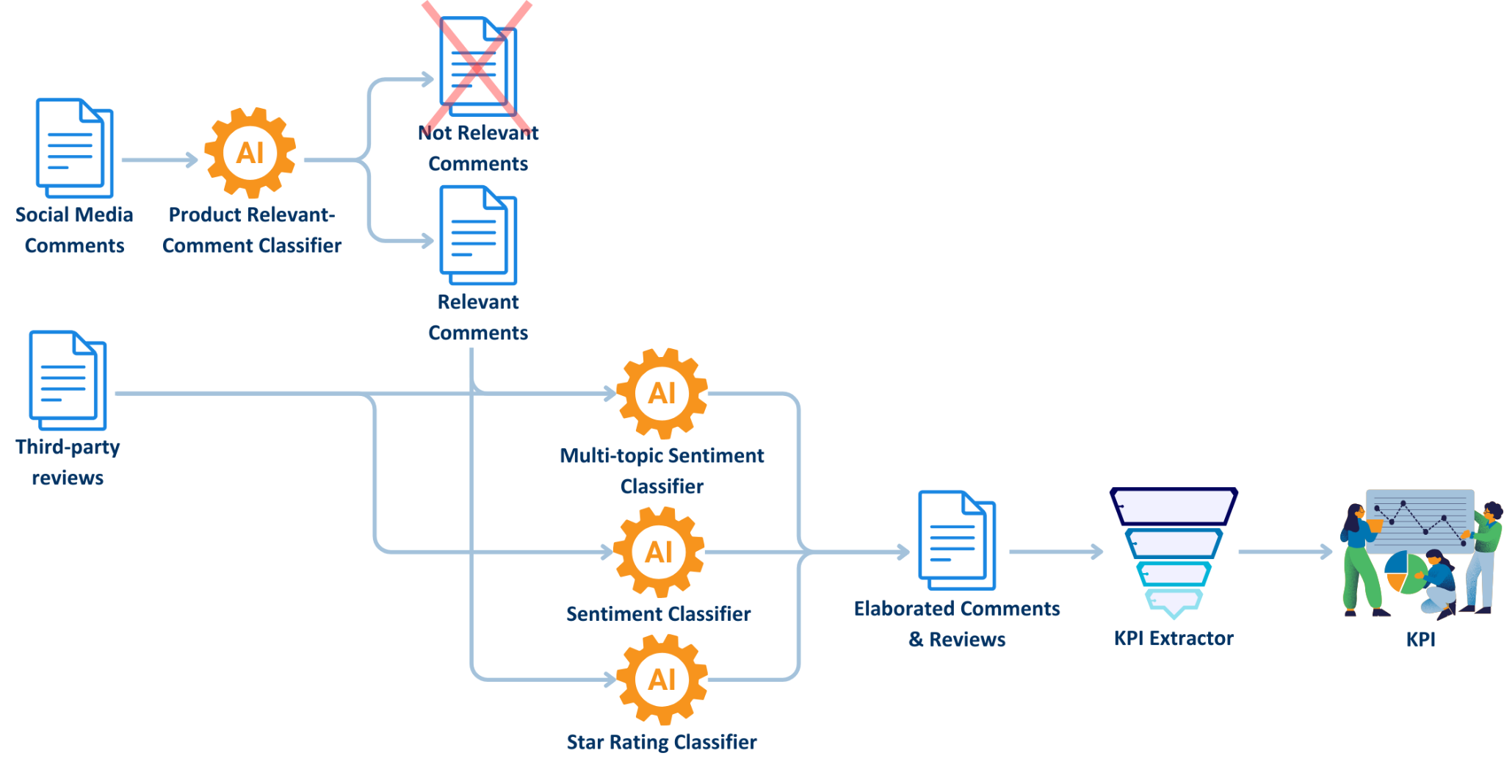
Method - Pipeline
Notes:
This is our model pipeline. At the start we have our product relevant-comment classifier, that basically analyze all the comments extracted for socials and discard the non relevant ones, so now we have clean our data. then these new data enters along with reviews in the core of our machine. Here we adopt 3 different classifier, the comments only go through the first two, the multi topic and the sentiment, on the other and the reviews go through the first and the last . Then finally after we have got our processed comments and review we apply to them the kpi to get the crucial market insight we are aiming for

Slide 7

Method - Classification Block and Models
The core of the pipeline is the classification block, responsible for all classification tasks. Its structure adapts to the model type used:
General-Purpose Models (Chat-like LLMs): Flexible and versatile for various tasks.
Specialized Task-Based Models: Fine-tuned for specific tasks, offering higher precision in narrow domains.
Notes:
At the core of our pipeline is the classification block, which handles all classification tasks. Its structure is adaptable based on the type of model used:
General-Purpose Models (Chat-like LLMs): These models offer flexibility and versatility, making them suitable for a wide range of tasks without extensive fine-tuning.
Specialized Task-Based Models: These models are fine-tuned for specific classification tasks, providing higher precision and reliability within narrow domains.
This adaptability ensures that our AI system can effectively process consumer comments and reviews, balancing flexibility with accuracy depending on the use case.

Slide 8
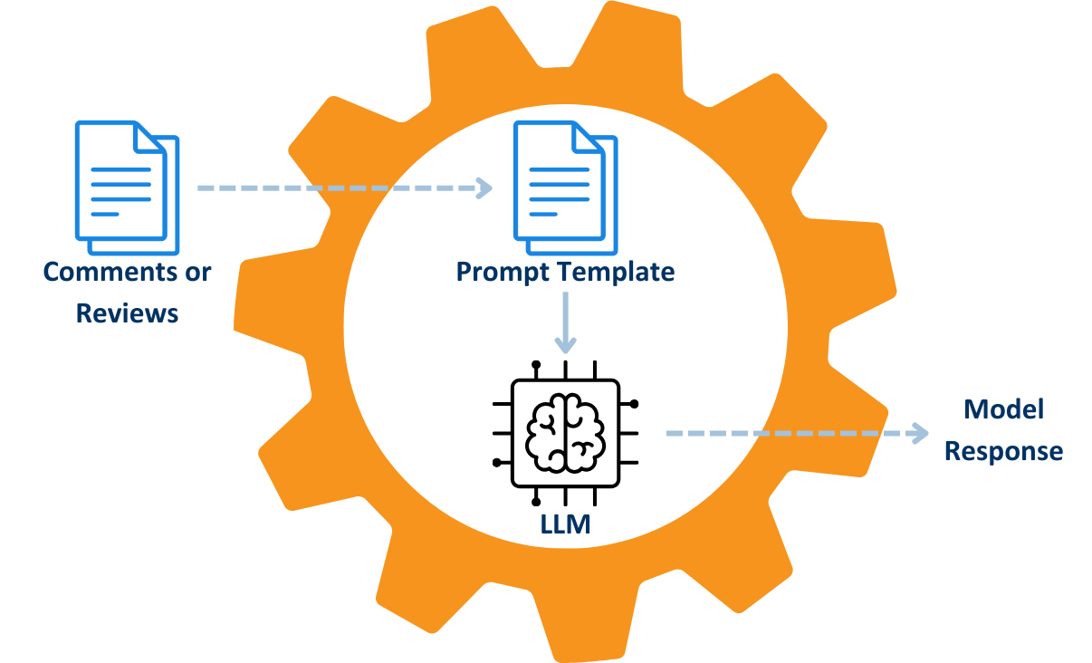
Method - General Purpose Classification Block
The general purpose classification block comprises two main components:
Prompt Template:
Clearly defines the classification task.
Includes examples (few-shot prompting only).
Specifies the structured output format for consistent model responses.
General-Purpose Model (LLM):
Processes the task-specific prompt (combining prompt template and input data).
Generates task-specific responses.
Notes:
The general-purpose classification block consists of two main components:
Prompt Template:
Clearly defines the classification task.
Includes examples for few-shot prompting when needed.
Specifies a structured output format to ensure consistent model responses.
General-Purpose Model (LLM):
Processes the task-specific prompt by combining the prompt template with input data.
Generates task-specific responses, ensuring relevant and structured outputs.
This design enables flexibility while maintaining consistency and accuracy across different classification tasks.

Slide 9



Method - General Purpose Models
Gemma2: large language model from Google, different versions: 2B, 9B and 27B
Llama3: large language model from Meta, 8B, 70B and 405B
Mistral: large language model from Mistral AI

Slide 10
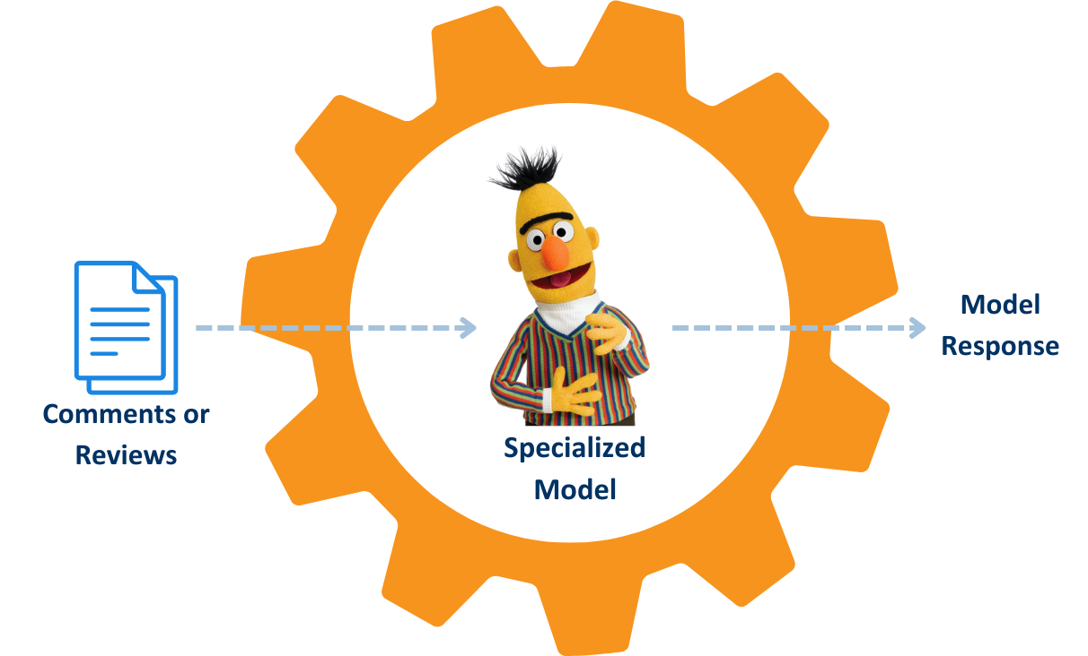
Method - Specialized Classification Block
The specialized model classification block comprises one main component:
Specialized BERT-base Model: Takes reviews or comments as input and generates a response based on the specific task.

Slide 11

Method - Specialized Models
Sentiment Classification
distilbert-base-multilingual-cased-sentiments
twitter-xlm-roberta-base-sentiment-finetuned
twitter-roberta-base-sentiment-latest
Star Rating Prediction
bert-base-multilingual-uncased-sentiment
multilingual-sentiment-analysis
*from Hugging Face

Slide 12
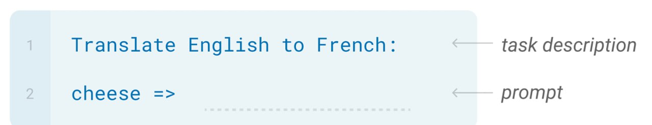
Method - Prompting Approach
Zero-shot:
The model predicts the answer given only the description of the task in natural language.

Slide 13
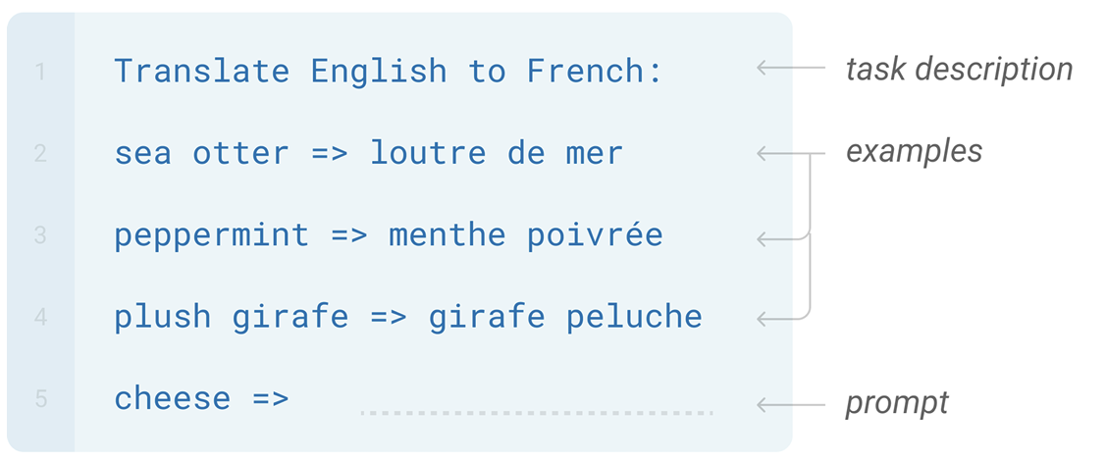
Method - Prompting Approach
Few-shot: The model sees a few examples of the task.

Slide 14





Experiments - Data
Data Sources:
Wonderflow
Digiming
YouTube
Instagram
Generative Models
Datasets:
Reviews
Comments
Synthetic Data

Slide 15
Experiments - Datasets
Reviews:
Records: 2930
Sampled records: 500
Star Rating label ration: 100%
Multi-Topic Sentiment label ratio: 95%
Tiny Eco Reviews: 79
Comments:
Records: 577
Labelled Comments: 0%
Tiny Eco Comments: 77
Synthetic Data:
Comments Records: 236
Reviews Records: 500
Labelled Comments and Reviews: 100%
Some reviews may have incomplete labels, e.g.:
“Excellent machine. Fair price and guaranteed quality.” - Positive Aspects: [“Price & worth”]
Where is “Coffee Quality”?

Slide 16
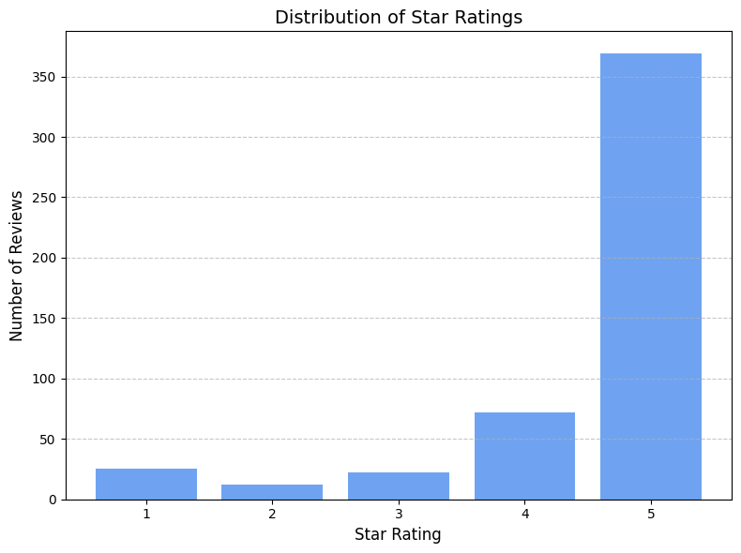
Experiments - Labels Distribution
Heavily skewed toward higher ratings!

Slide 17
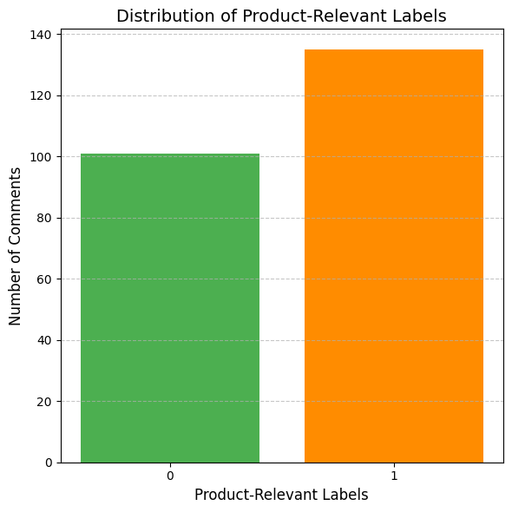
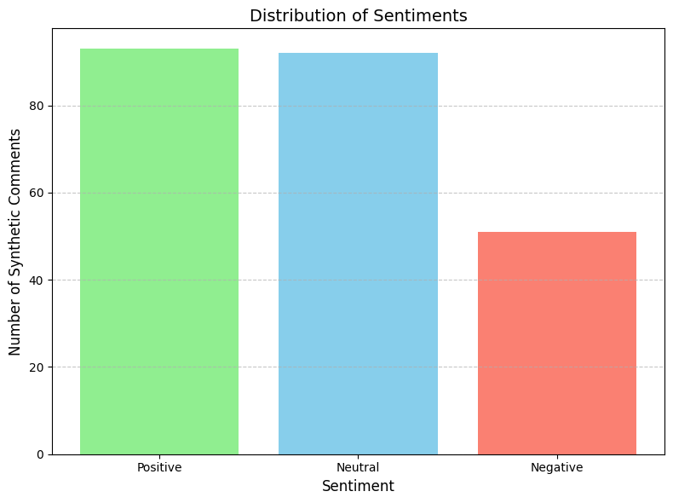
Experiments - Labels Distribution
Much more balanced!

Slide 18
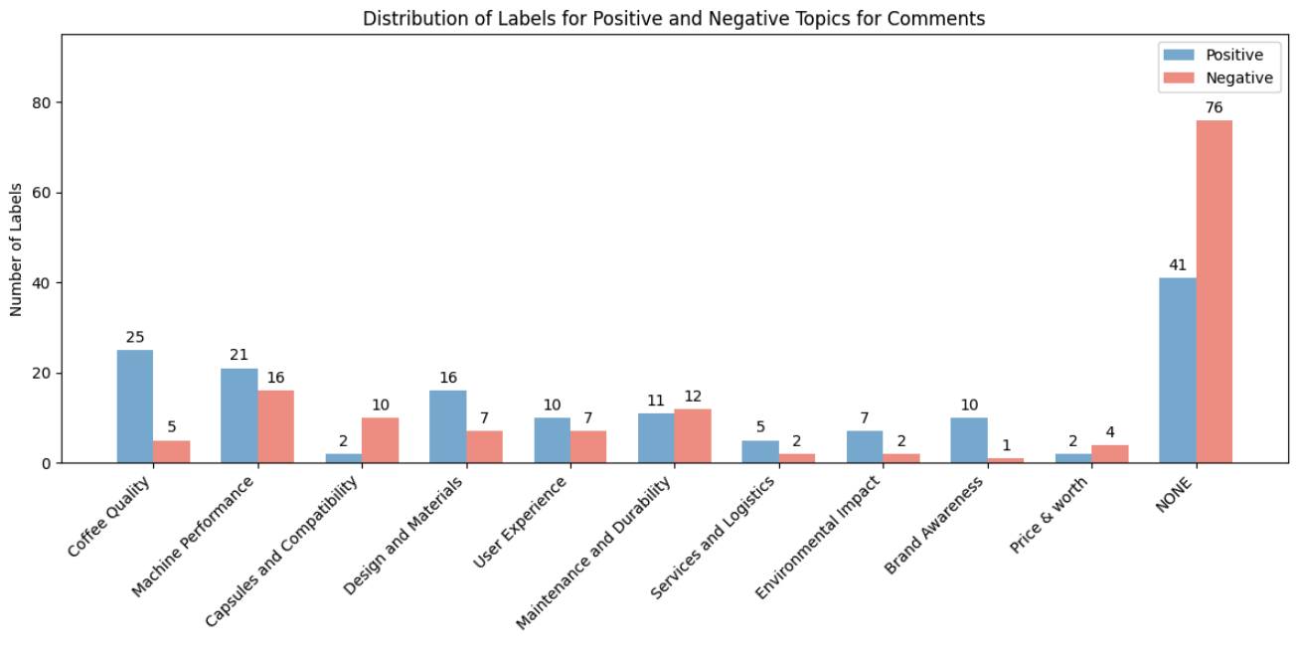
Experiments - Labels Distribution
*NONE: topics different from the predefined ones.

Slide 19
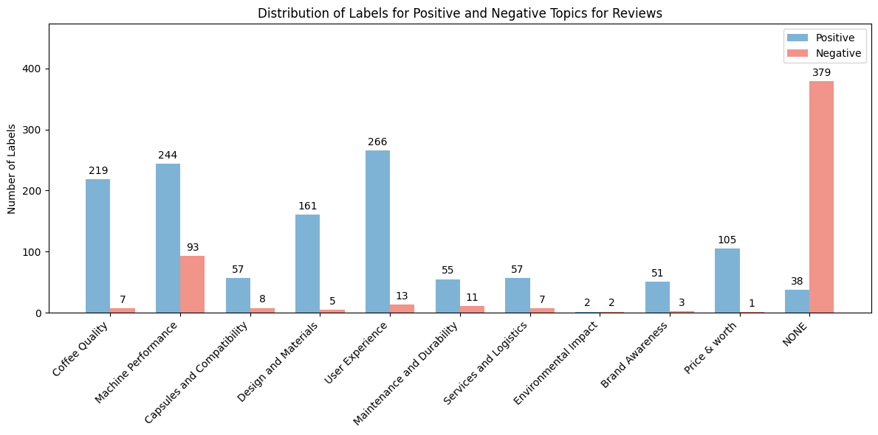
Experiments - Labels Distribution
*NONE: topics different from the predefined ones.

Slide 20

Experiments - Tasks
Product Relevant-Comment Classification
Multi-topic Sentiment Classification
Positive Topics
Negative Topics
Sentiment Classification
Positive
Negative
Neutral
Star Rating Prediction:
Notes:
We have identified four main tasks that our model needs to perform. The first one is Product Relevant Comment Classification: here we take the comments that we have scraped off the internet and we want to understand which ones are actually relevant to the product that is being taken in consideration. The rest of them are just noise and can be discarded. Then we have Multi-topic Sentiment Classification which is the most complex task that we perform. Here we take both comments and reviews and we want to understand what topics are being discussed within each one of them, and whether these topics are discussed in a positive or negative manner.
So,while here we go in the specific of the text, in the Sentiment Classification task we take the whole comment and assign a positive, negative or neutral label. Then in Star Rating Prediction, used for reviews, we assign a score from 1 to 5, and base our evaluation on that.

Slide 21
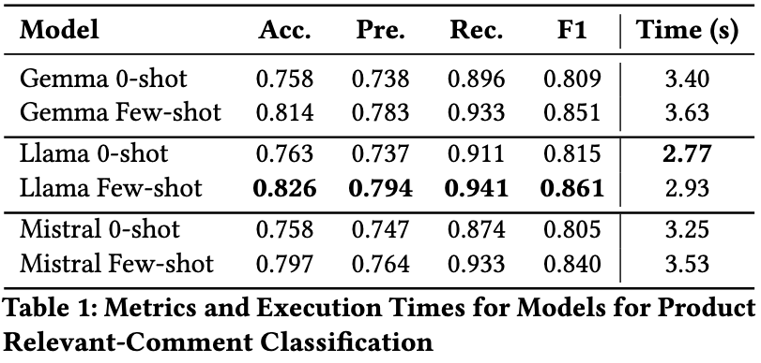
Experiments - Product Relevant-Comment
Classification
Data: 236 synthetic comments
Batch-size: 15 comments
Notes:
These are results for the Product Relevant Comment classification, where we can see that the results in all metrics and in inference time are achieved by LLama. The zero shot version is faster but few shot achieves higher scores.

Slide 22
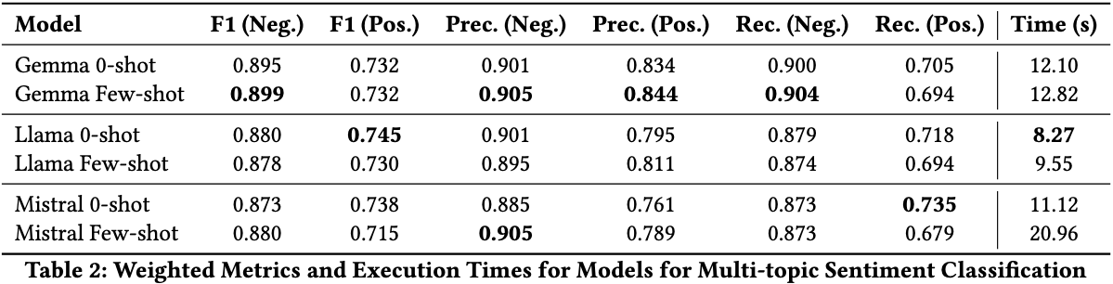
Experiments - Multi-topic Sentiment
Classification
Data: 500 labeled reviews + 236 synthetic comments
Batch-size: 5 comment/review
Notes:
In the case of Multi-topic sentiment classification we opted for weighted metrics, to address the issues with the balance of the dataset that Tommaso presented earlier. This is done to prevent less frequent categories from being overshadowed by dominant ones and to provide a more representative evaluation of performance across all categories. Here the model that performs the best is Gemma in its fewshot configuration, even though it is significantly slower than LLama.

Slide 23
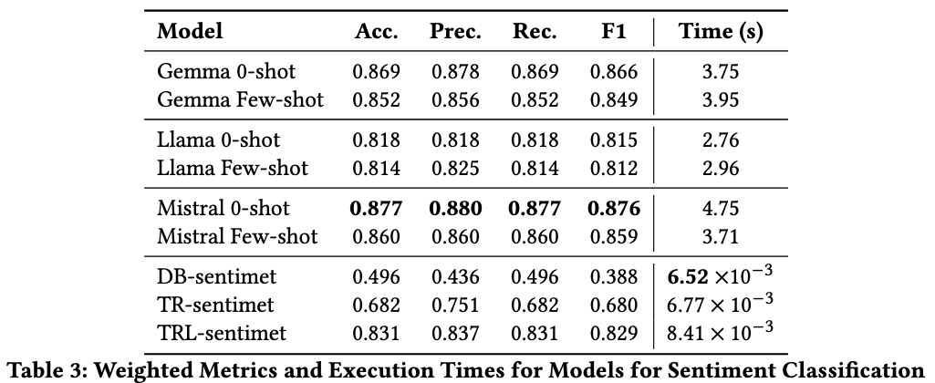
Experiments - Sentiment Classification
Data: 236 synthetic comments
Batch-size: 20 (general purpose model) and 50 (specialized model)
Notes:
Sentiment classification is a really common task, for this reason there exist already many specific models that are finetuned for the task. Here we can see that these model cannot compete with the general purpose models in terms of scoring, but they are incomparably faster than than them, with Twitter Roberta latest in particular achieving a pretty high score.
It’s interesting to note that in this case the zero shot configuration achieved better results than few-shot, suggesting that for easier task a smaller prompt can be beneficial.

Slide 24
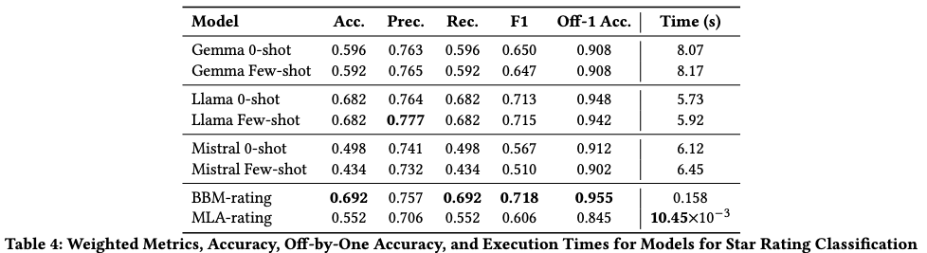
Experiments - Star Rating Prediction
Data: 500 labeled reviews
Batch-size: 20 (general purpose model) and 50 (specialized model)
Notes:
For star rating prediction the specific models other than being extremely fast also obtain the best results.

Slide 25
Conclusion
We can conclude by saying that:
LLMs are able to identify relevant product comments, with an accuracy of up to 82.6%.
LLMs are able to extract product aspects from reviews and comments and assign sentiment to them, with an F1 score of up to 89.9% for negative aspects and 74.5% for positive aspects.
LLMs are able to assign sentiment to comments and rating stars to reviews, with an accuracy of up to 87.7% and 69.2% (95,5 off-by-one) respectively.
Notes:
Given the results of the experiments, we can say in conclusion:

Slide 26
Conclusion
In conclusion we chose these models:
Gemma 2 few-shot: for Product Relevant-Comment Classification and Multi-topic Sentiment Classification.
Twitter RoBERTa latest: for Sentiment Classification.
BERT base multilingual: for Star Rating Prediction.

Slide 27
Thank you
Alessio Gioè - Catalano Vincenzo - Tommaso Mazzarini

